Slide 1

RegEx Matching: Independent Connector
Mitanshu Garg
@mitanshu

Slide 2





Hi, I am Mitanshu
Digital Cell Lead
Russia | United Kingdom | United States
Microsoft Power Champions Community
PL-900: Power Platform Fundamentals
PL-100: Power Platform Functional Consultant
Digital Special Agent 018
Super User 2022 Season 1
Microsoft Power Users Community

Slide 3
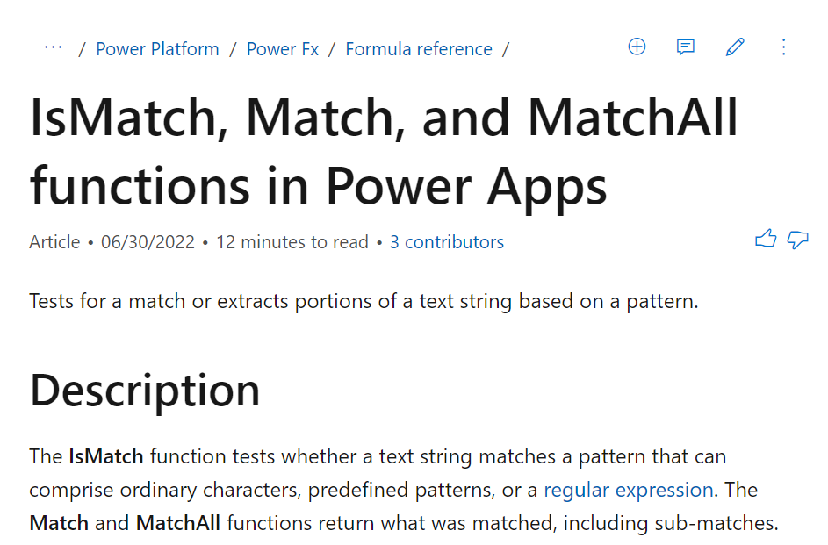

RegEx Matching in Power Automate
Regular expression pattern matching available out of the box for Power Apps
No out of the box solution within Power Automate
Independent Connector to the rescue

Slide 4
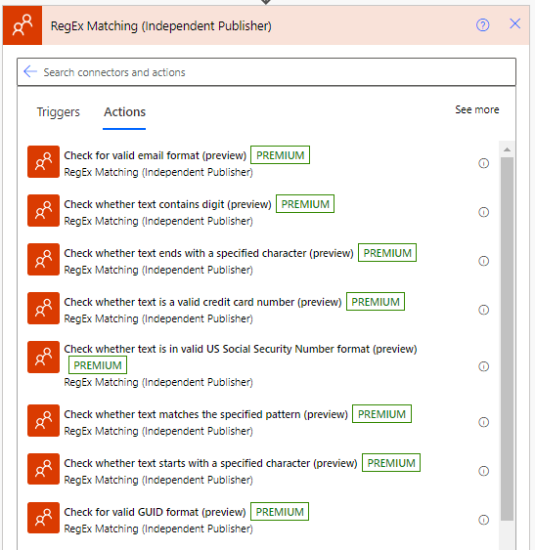
Various use cases such as to validate end-user data input in multiple scenarios
Returns true or false if the input string matches the regular expression
Multiple pre-defined expressions or developer can provide their own custom regular expression

Slide 5
Demo

